Slide 1
Worship
https://youtu.be/y2VhXwpANgI (Power In the Blood)
https://youtu.be/J2NzLqpod0I (Ill Fly Away)
https://youtu.be/qxOW3e5m9a0 (No Holding Back…Alliance Worship)

Slide 2
Video
Titus Sermon Series: Bumper Video - YouTube

Slide 3
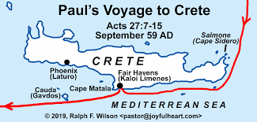
Crete

Slide 4
Paul's Journey To Crete
Acts 27:5-15
Paul Told the centurion about danger on the voyage.
Crete is where Paul sent Titus the young Pastor.

Slide 5
Written by Paul A.D. 62-64
Main Themes of Titus:
1. The need for proper leadership 1:5-9
2. Watching for false teachers 1:1-16
3. How to live as a true believer 2:1-3
4. Principle of the Gospel 3:3-7

Slide 6
Titus 2:1-3
Be self-controlled (Titus 2:1-5)
Men we are to set examples as leaders
Men are to be sober-minded and be able to think clearly
Men are to be self-controlled.

Slide 7
Titus 2:3-5
Older women are to set good examples as leaders.
Women are to love their husbands
When I think of a leader, I look at my wife, she is hard working at school, at home she makes sure the house is running smoothly with the groceries, setting the appointments, and setting an example with her health.

Slide 8

Wife Setting an example of Health

Slide 9
God wants
Christians gather- to equip- to scatter
Jesus isn’t a 800 number to call when in need; He is the life giving, life altering, sanctifier, and God wants us live in Christ.

Slide 10
Conclusion
Be careful how you are acting among your peers, show people the love of Christ, and Go and make disciples, growing the kingdom of God one soul at a time.

